Slide 1
IMPLEMENTAREA CONCURENTEI IN LIMBAJE DE PROGRAMARE 2025-2026
Curs:
Ioana Leustean
ioana.leustean@unibuc.ro
Laborator:
Bogdan Macovei
bogdan.macovei@unibuc.ro

Slide 2
Resurse: MSTeams
Sistem de notare: examen in sesiune (obligatoriu, maxim 10 puncte) si
proiect (optional, maxim 10 puncte)
Proiect
echipe cu maxim 2 membri
prezentare pe slideuri si referat
Examen in sesiune
probleme asemanatoare celor din curs si laborator
se va impune un limbaj pentru rezolvarea unei probleme
Promovare: punctaj examen >=5
Nota finala: max(nota examen, 1 + (nota proiect + nota examen)/2)
Puncte suplimentare pentru activitatea din timpul semestrului (maxim 2 puncte)

Slide 3
"Concurrency is an interesting word because it means different things to different peo‐
ple in our field. In addition to “concurrency,” you may have heard the words, “asyn‐
chronous,” “parallel,” or “threaded” bandied about. Some people take these words to
mean the same thing, and other people very specifically delineate between each of
those words."
Katherine Cox-Buday, Concurrency in Go, O'Reilly, 2017

Slide 4
"In the computer world, when we talk about concurrency, we refer to a series of independent and unrelated tasks that run simultaneously on a computer. This simultaneity can be real if the computer has more than one processor or a multi-core processor, or it can be apparent if the computer has only one core processor.
Another concept related to concurrency is parallelism. There are different definitions and relations with the concurrency concept. Some authors talk about concurrency when you execute your application with multiple threads in a single-core processor. With this, you can see when your program execution is apparent. They talk about parallelism when you execute your application with multiple threads in a multi-core processor or in a computer with more than one processor […]"
Gonzalez, Javier Fernandez. Java 9 Concurrency Cookbook - Second Edition Packt Publishing. 2017
.

Slide 5
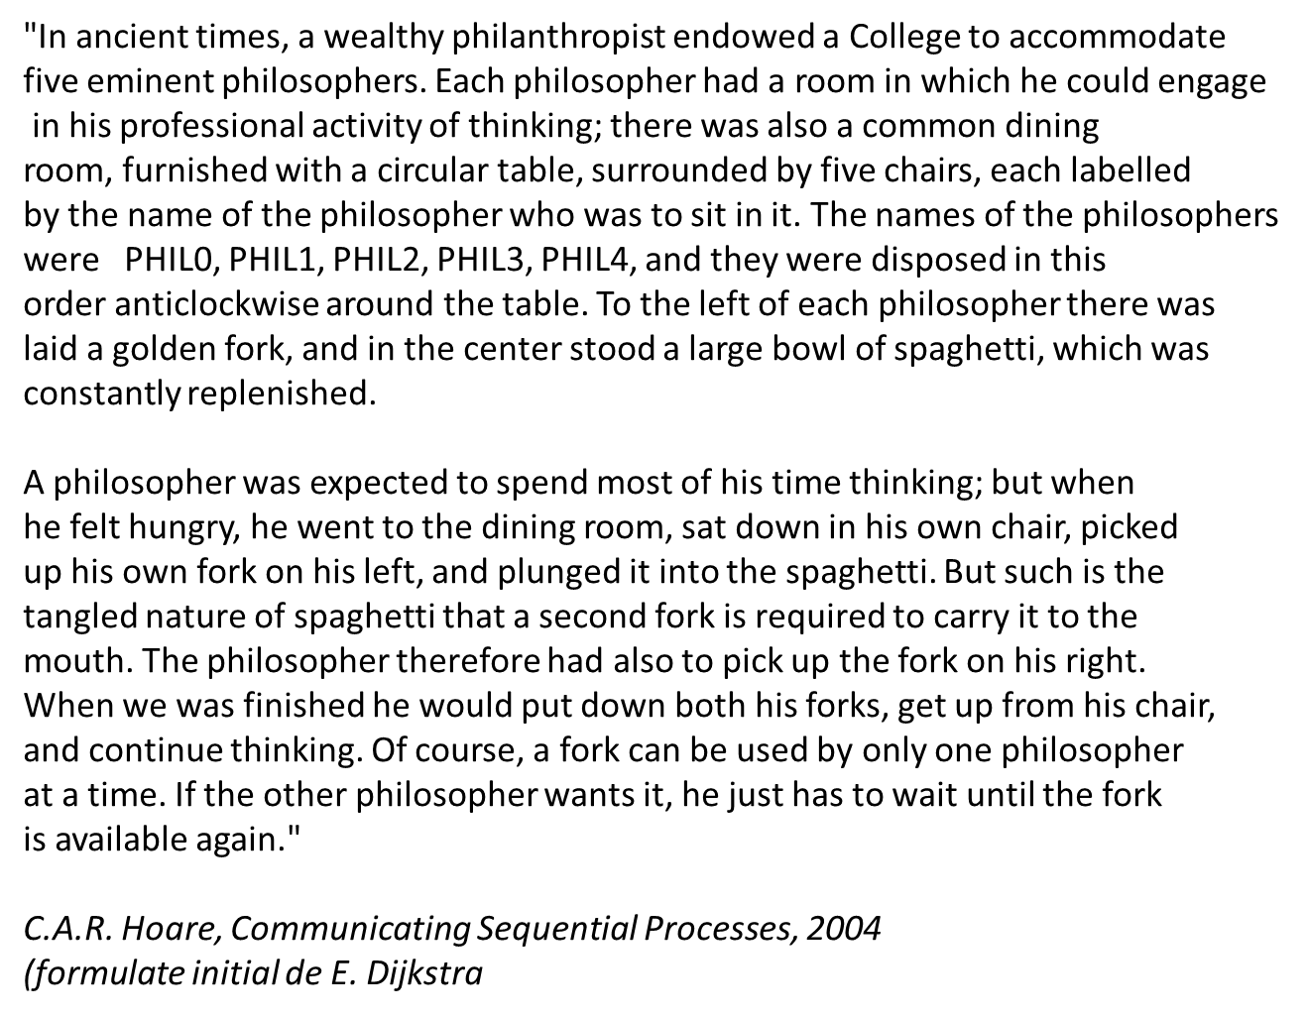
Dining Philosophers Problem

Slide 6
Limbaje concurente
Scopul programarii concurente este de a descrie programe cu multe interactiuni:
intre utilizatorii aceleiasi interfete, intre subsistemele aceluiasi sistem, intre sisteme diferite.
Un limbaj de programare concurent este un limbaj care ofera constructii sintactice explicite
prin care se pot descrie aceste interactiuni.
Un program concurrent este un program scris intr-un limbaj de programare concurrent.
Comportamentul unui program concurent este independent de sistemul de operare.

Slide 7
Metode de implementare a concurentei
Thread-uri si memorie partajata
Software Transactional Memory
Modelul cu Actori
In acest curs vom analiza toate aceste metode !
Limbajele studiate la curs: Java, Go, Haskell, Erlang

Slide 8
Thread-uri
Probleme:
Deadlock
Date Race
Starvation
Livelock
Un thread este o secventa de instructiuni in interiorul unei aplicatii/unui proces.
O aplicatie poate contine mai multe thread-uri.
Threadurile pot fi executate in parallel, dar in interiorul fiecarui thread operatiile sunt secventiale.
Thread-urile isi impart resursele si comunica intre ele.
Comunicarea pote fi sincrona sau asincrona.
Metode pentru controlul
accesului la resurse:
sincronizare
Semafoare
Monitore

Slide 9
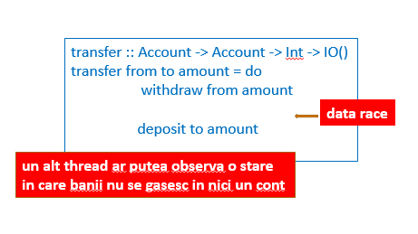
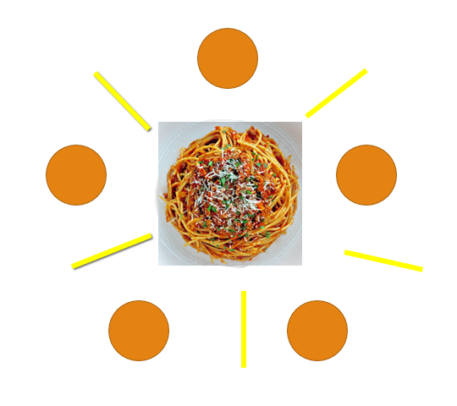
Data Race = apare cand mai multe threaduri acceseaza concurrent aceeasi locatie de memorie fara mecanisme de sincronizare adecvate; codul poate functiona corect in unele situatii dar eronat in altele.
Dining Philosophers
Deadlock = apare cand doua sau mai multe threaduri se asteapta
unul pe celalalt pentru a elibera accesul la resurse
Starvation = apare cand unui thread i se refuza continuu accesul la resurse
Livelock = apare cand doua sau mai multe threaduri actioneaza, blocandu-se unul pe celalalt

Slide 10
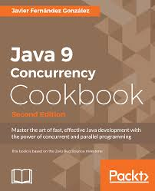
Thread-uri si memorie partajata
"When you work with a computer, you can do several things at once. You can listen to music while you edit a document in a word processor and read your e-mails. This can be done because your operating system allows the concurrency of tasks. Concurrent programming is about the elements and mechanisms a platform offers to have multiple tasks or programs running at once and communicating with each other, to exchange data or to synchronize with each other. Java is a concurrent platform, and it offers a lot of classes to execute concurrent tasks inside a Java program. With each version, Java increases the functionalities offered to programmers to facilitate the development of concurrent programs."
Gonzalez, Javier Fernandez. Java 9 Concurrency Cookbook - Second Edition, Packt Publishing. 2017

Slide 11
Atribuire
(assignment)
x:= 2 +3
Tratarea concurentei este ingreunata de
sincronizarea accesului resurse
efectele laterale
nedeterminism
In programarea functionala:
datele sunt imuabile
o expresie poate fi inlocuita cu valoarea ei
functiile nu au efecte laterale
valoarea calculata de o functie depinde numai de
valorile argumentelor
Legatura
(binding)
x= 2+3
immutability
referential transparrency

Slide 12
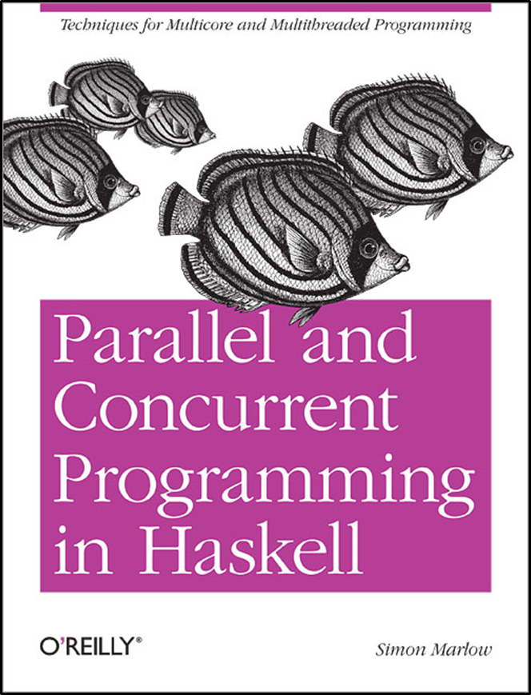
STM (Software Transactional Memory)
"Haskell does not take a stance on which
concurrent programming model is best:
actors, shared memory, and transactions are all supported, for example."
"Haskell provides all of these concurrent programming models and more - but this flexibility is a double-edged sword.
The advantage is that you can choose from a wide range of tools and pick the one best suited to the task at hand,
but the disadvantage is that it can be hard to decide
which tool is best for the job."
S. Marlow

Slide 13
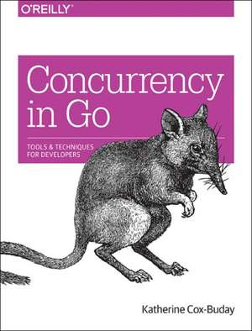
Goroutines and channels
"Before Go was first revealed to the public, this was where the chain of abstraction ended for most of the popular programming languages. If you wanted to write concurrent code, you would model your program in terms of threads and synchronize the access to the memory between them. If you had a lot of things you had to model
concurrently and your machine couldn’t handle that many threads, you created a thread pool and multiplexed your operations onto the thread pool.
Go has added another link in that chain: the goroutine. In addition, Go has borrowed several concepts from the work of famed computer scientist Tony Hoare, and introduced new primitives for us to use, namely channels.
…
Threads are still there, of course, but we find that we rarely have to think about our problem space in terms of OS threads. Instead, we model things in goroutines and channels, and occasionally shared memory."

Slide 14

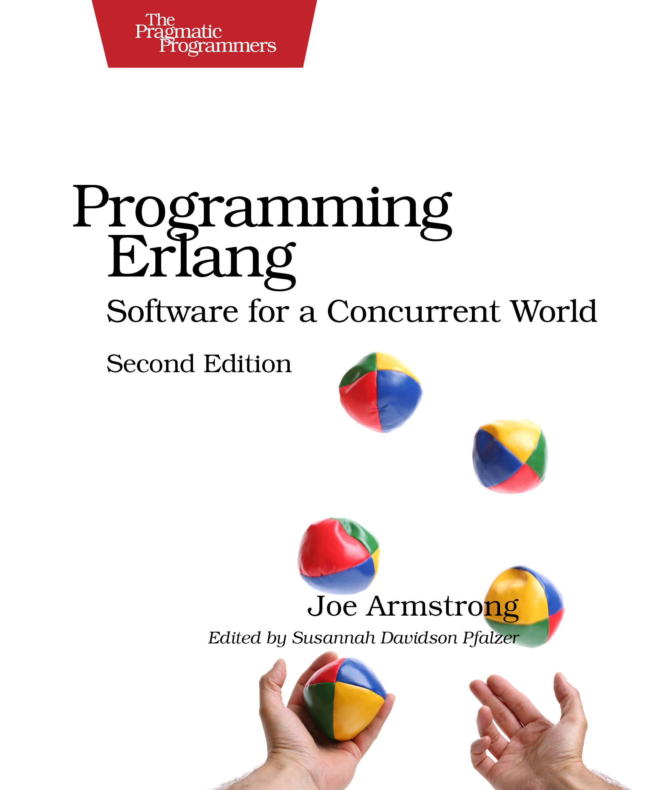
Modelul cu Actori
"Erlang was designed from the bottom up to program concurrent, distributed,
fault-tolerant, scalable, soft, real-time systems. […]
If your problem is concurrent, if you are building a multiuser system, or if
you are building a system that evolves with time, then using Erlang might
save you a lot of work, since Erlang was explicitly designed for building such
systems. […]
Processes interact by one method, and one method only, by exchanging
messages. Processes share no data with other processes. This is the reason
why we can easily distribute Erlang programs over multicores or networks. "
Joe Armstrong, Programming Erlang, Second Edition 2013

